Slide 1

PicATrip

Slide 2
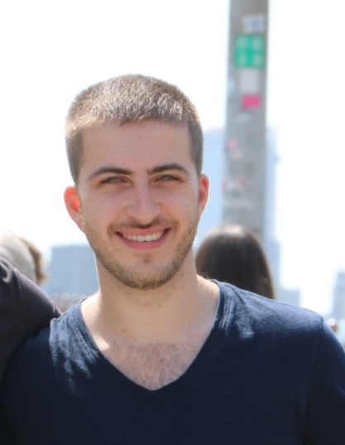
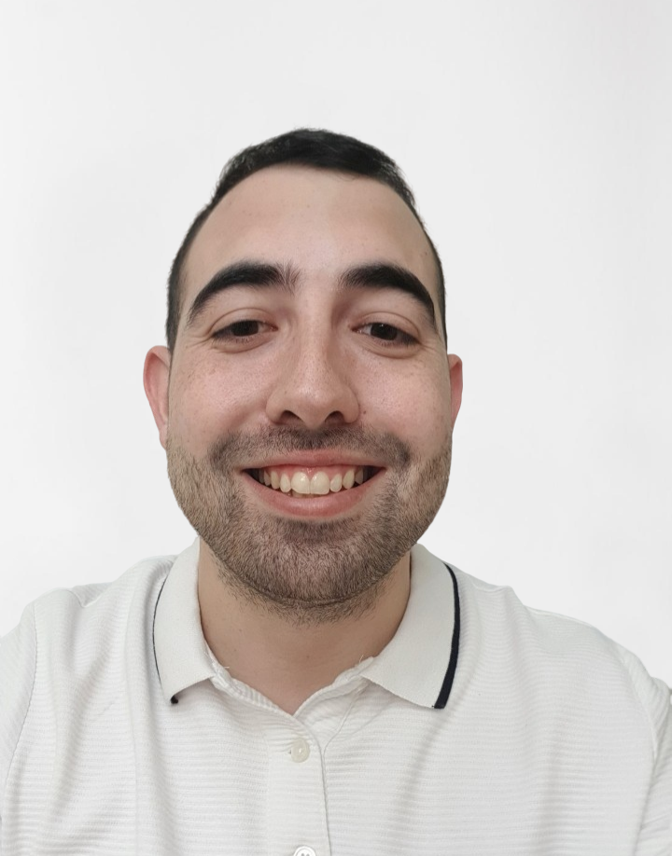
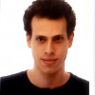
Team
Leead Arbetman
25, Haifa
Second year student of Computer Science.
Hobbies: soccer & chess
Nadav Spinco
26, Rishon Lezion
Third-year student of Computer Science, Teaching assistant on programing courses at MTA.
Amir Miller
30, Tel-Aviv
Fourth year student of Computer Science, worked with firebase and embedded systems.

Slide 3

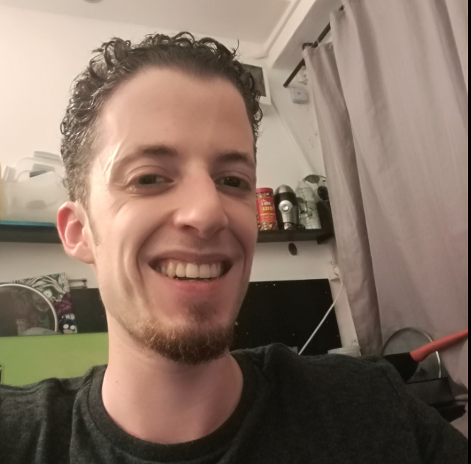
Team
Shoval Ovadia
26, Gan Yavne
Second year student of Computer Science.
Ma’ayan Hadar
25, Bat-Yam
Third year student of Computer Science, work experience in QA and data analyst.

Slide 4
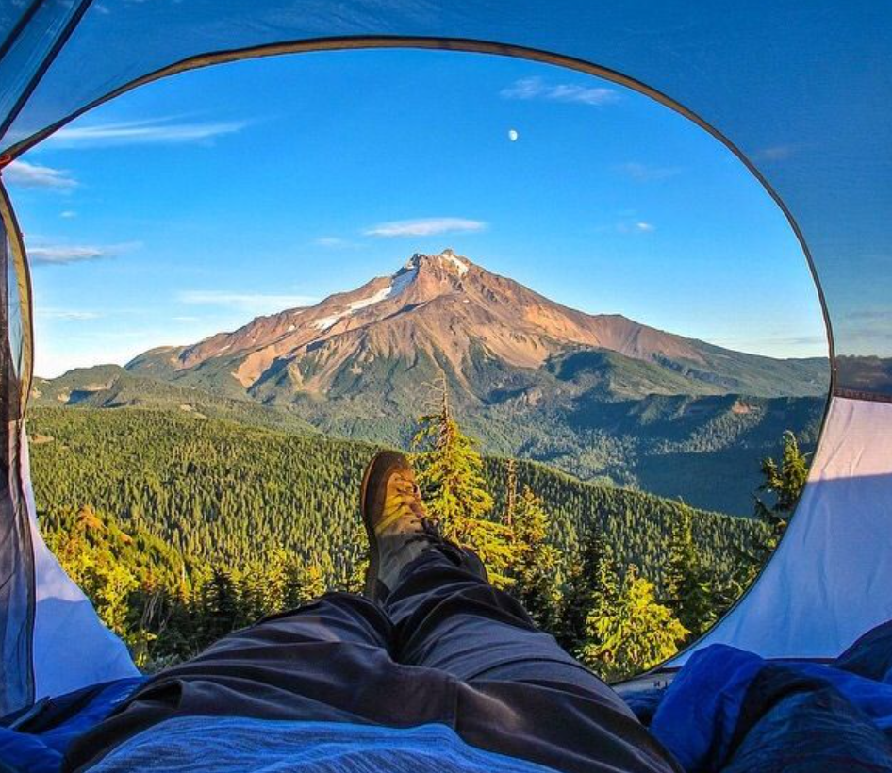
Goals
Our main goal is to encourage people to travel our beautiful country.
PicATrip is a web app where users can suggest trips, share their experiences based on photos and discuss them with friends.
“A photo is worth a thousand words”

Slide 5
Features
Share pics of your trips and describe the whole experience
Add useful information in predefined categories
Comment on posts by other users: share your own experience and attach tags
Search the database by area, popularity, or recent additions
Sort and filter the result by reactions
View content without registration; sign in to add your own

Slide 6

THANK YOU FOR LISTENING

